Slide 1
Azure DevOps With Databases In 15 Minutes

Slide 2




… in this session

Slide 3

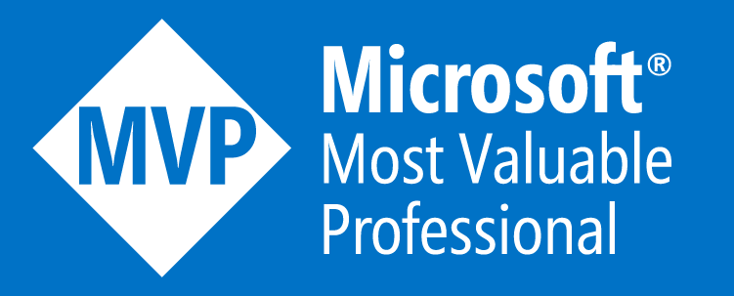







@sqlstad
sqlstad.nl
sander@sqlstad.nl
github.com/sanderstad

Slide 4
Why this session

Slide 5
Some arguments people come up with
My company is too small for DevOps
It will cause more errors than it fixes
Developers and Operations do not mix well
Why change the way we do it now
Implementing DevOps is expensive

Slide 6
Counter arguments
Testing will improve
Deployment frequency will go up
Improve response to business needs
More time for experimentation
Stable releases

Slide 7
How?!

Slide 8

You need tools
Visual Studio
PowerShell
tSQLt
Azure DevOps

Slide 9
Visual Studio & SSDT
Create SSDT project using template
Import the current database schema
Generate basic unit tests

Slide 10


Slide 11
What tests are being generated
Object Existence
Database Collation
Function Parameters
Procedure Parameters
Table Columns
Table Constraints
Index Columns
View Columns

Slide 12
Azure DevOps
Create a project
Setup build pipeline
Run tests

Slide 14
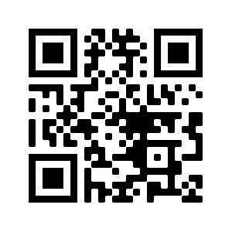
Tools overview
Visual Studio https://visualstudio.microsoft.com/vs/community/
PSModuleDevelopment https://psframework.org/
SSDT Template https://github.com/sanderstad/SSDT-With-tSQLt-Template
PStSQLtTestGenerator https://github.com/sanderstad/PStSQLtTestGenerator

Slide 15


